Slide 1

Invoice import and export improvements
Presenter: Liberuum, meraki, BAI team
Date: 02/28/25

Slide 2
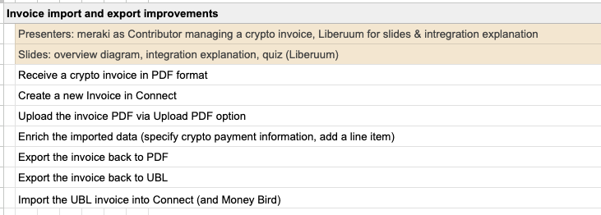
Demo Flow

Slide 3

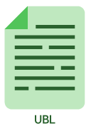
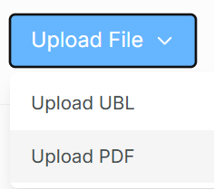
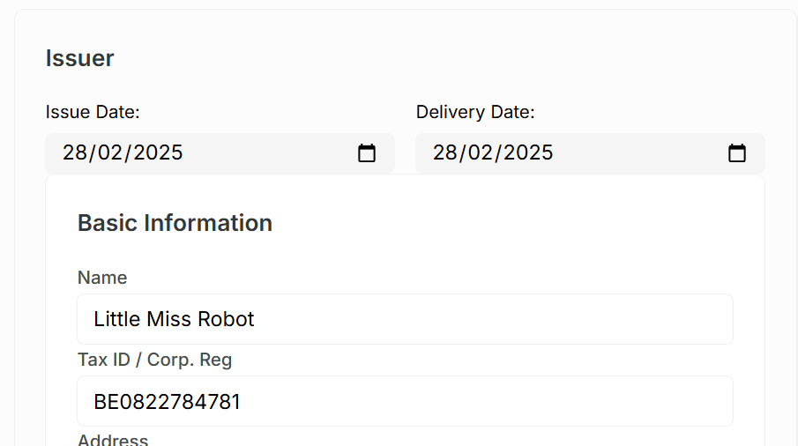
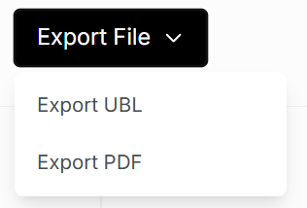
Diagram
Contributor
Invoice is populated
Uploads PDF Invoice to Connect
Export Invoice to UBL/PDF

Slide 4
In focus: Upload PDF
Using Google Document AI PDF document parser
Continuous trainable model to improve PDF reading
Can be used for other types of documents in Connect
Extracts relevant information from PDF
Returns extracted data back to Connect
Connect populates invoice with data

Slide 5
In focus: Export UBL
UBL export uses internal script in Connect to prepare
Data and have it exported into a UBL format file.

Slide 6
Demo Time

Slide 7
Questions?

Slide 8
Demo Quiz

Slide 9
#1 Question
How many export/import options in total does the Invoice document have?
5
4
3
6
-> Name these options

Slide 10
#2 Question
Which import option is using AI to extract data?
?

Slide 11
#3 Question
Which AI Product has been integrated to the invoice document in this demo?
?

Slide 12


2025 Roadmap Timeline
Q1 (03/31)
Q2 (06/27)
Q3
Q4
Powerhouse OH Package Have 100% of the contributor billing & payments for Powerhouse & Jetstream teams go via Powerhouse software & integrations
Headline
Text that explains what happened at this point in time
Headline
Text that explains what happened at this point in time
Headline
Text that explains what happened at this point in time
* Sky SubDAO 2025
* Decentralized Operations 2025
* Builder Platform 2025

Slide 13
Slide Templates

Slide 17
What DAO processes would you capture in a model?
Add a statement here that imagines a new future scenario envision a better future.
#hashtagterm #hashtagterm
Notes:
AI readiness: AI and automation is a rapidly developing phenomenon that every organization needs to be prepared for -> need to have the right base infrastructure > "How do you plugin AI & other tools to automate your process. Did you use the right foundation to enable this?

Slide 18




Decentralised Data Architecture
12 pt Text that explains each of the features in detail while not being to small to read. We could also highlight essential words to grab attention.
12 pt Text that explains each of the features in detail while not being to small to read. We could also highlight essential words to grab attention.
12 pt Text that explains each of the features in detail while not being to small to read. We could also highlight essential words to grab attention.
12 pt Text that explains each of the features in detail while not being to small to read. We could also highlight essential words to grab attention.

Slide 19

Decentralised Data Architecture
12 pt Text that explains each of the features in detail while not being to small to read. We could also highlight essential words to grab attention.
12 pt Text that explains each of the features in detail while not being to small to read. We could also highlight essential words to grab attention.

Slide 20
Decentralised Data Architecture
Adding a block of text that provides sufficient information about why, where and how we operate in a decentralised fashion.

Slide 21
USPs

Slide 22

This could be the
Title of a chapter
We create the legal templates to structure new organizational designs. We help contributors to feel confident.

Slide 23
Decentralised Data Architecture
12 pt Text that explains each of the features in detail while not being to small to read. We could also highlight essential words to grab attention.
12 pt Text that explains each of the features in detail while not being to small to read. We could also highlight essential words to grab attention.

Slide 24
Decentralised Data Architecture
12 pt Text that explains each of the features in detail while not being to small to read. We could also highlight essential words to grab attention.
12 pt Text that explains each of the features in detail while not being to small to read. We could also highlight essential words to grab attention.

Slide 25
Decentralised Data Architecture
12 pt Text that explains each of the features in detail while not being to small to read. We could also highlight essential words to grab attention.
12 pt Text that explains each of the features in detail while not being to small to read. We could also highlight essential words to grab attention.

Slide 26
Decentralised Data Architecture
12 pt Text that explains each of the features in detail while not being to small to read. We could also highlight essential words to grab attention.
12 pt Text that explains each of the features in detail while not being to small to read. We could also highlight essential words to grab attention.

Slide 27
Decentralised Data Architecture
12 pt Text that explains each of the features in detail while not being to small to read. We could also highlight essential words to grab attention.
12 pt Text that explains each of the features in detail while not being to small to read. We could also highlight essential words to grab attention.

Slide 28
Decentralised Data Architecture
12 pt Text that explains each of the features in detail while not being to small to read. We could also highlight essential words to grab attention.
12 pt Text that explains each of the features in detail while not being to small to read. We could also highlight essential words to grab attention.

Slide 29
Decentralised Data Architecture
Adding a 16pt subtitle
12 pt Text that explains each of the features in detail while not being to small to read.
Adding a block of text that provides sufficient information about why, where and how we operate in a decentralised fashion.
Adding a 16pt subtitle
12 pt Text that explains each of the features in detail while not being to small to read.
Adding a 16pt subtitle
12 pt Text that explains each of the features in detail while not being to small to read.

Slide 30
143
16
1
143 years of combined DAO experience
Crypto native team members working on a dream of transparent open organisations
Dream to bring alive

Slide 31
Decentralised Data Architecture
Adding a 16pt subtitle
12 pt Text that explains each of the features in detail while not being to small to read.
Adding a block of text that provides sufficient information about why, where and how we operate in a decentralised fashion.
Adding a 16pt subtitle
12 pt Text that explains each of the features in detail while not being to small to read.
Adding a 16pt subtitle
12 pt Text that explains each of the features in detail while not being to small to read.

Slide 32
“
Add the desired quote here and lay out all of the other elements nicely so the page becomes pleasing to the eye.
Wouter Kampmann Powerhouse Team Lead Former head of engineering at Maker Foundation

Slide 35
Timeline Slide
2020
2022
2024
NOW
Text that explains what happened at this point in time
Text that explains what happened at this point in time
Text that explains what happened at this point in time
Text that explains what happened at this point in time
Notes:
It's messy and inefficient to work with 25 different tools and apps because integration sucks -> need to start from an integrated solution and only use specialized apps for specific core business areas

Slide 36




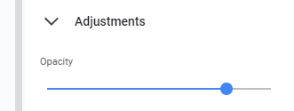
Active Powerhouse Projects
Protocol Expense Accounting
Project-Based Workflow
Integrated Real World Asset Reporting
Powerhouse Proof of Concept

Slide 37
2020
Title Text that explains what happened at this point in time
2021
Title Text that explains what happened at this point in time
Notes:
It's messy and inefficient to work with 25 different tools and apps because integration sucks -> need to start from an integrated solution and only use specialized apps for specific core business areas

Slide 38
2022
Title Text that explains what happened at this point in time
2023
Title Text that explains what happened at this point in time
Notes:
It's messy and inefficient to work with 25 different tools and apps because integration sucks -> need to start from an integrated solution and only use specialized apps for specific core business areas

Slide 39

2024
Title Text that explains what happened at this point in time
2025
Title Text that explains what happened at this point in time
Notes:
It's messy and inefficient to work with 25 different tools and apps because integration sucks -> need to start from an integrated solution and only use specialized apps for specific core business areas

Slide 40
Distributed Team
Adding a block of text that provides sufficient information about why, where and how we operate in a distributed fashion.

Slide 41
Explainer of the Mock-up or visualisation without to much text so the image speaks for itself.

